Slide 1
Optical communications and data networks (EENGM2001) Week15_Lecture017_ASync_BiDirectionalComms
Siddarth K Joshi

Slide 2
Intro
We have seen how to build one link,
Point A to Point B.
How do we get information to flow the other way as well?

Slide 3
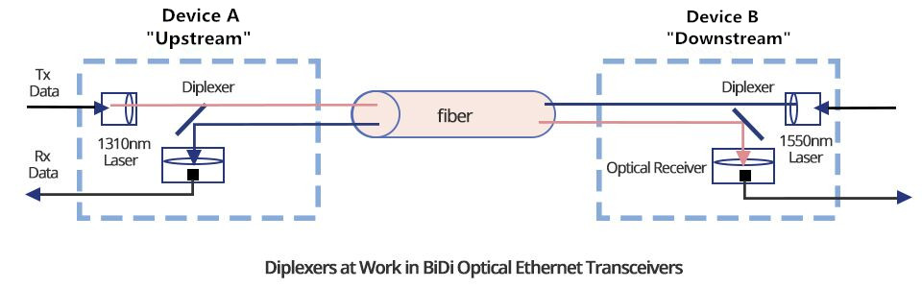
BiDi

Slide 4
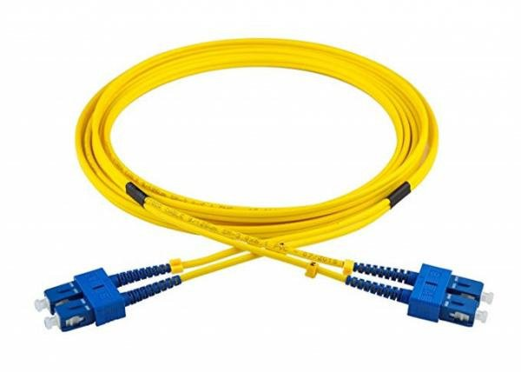

Standard practice
Migration to BiDi in progress
Most still use a fibre pair
Cheap BiDi will use 1310nm and 1550nm or similar v. different wavelengths

Slide 5
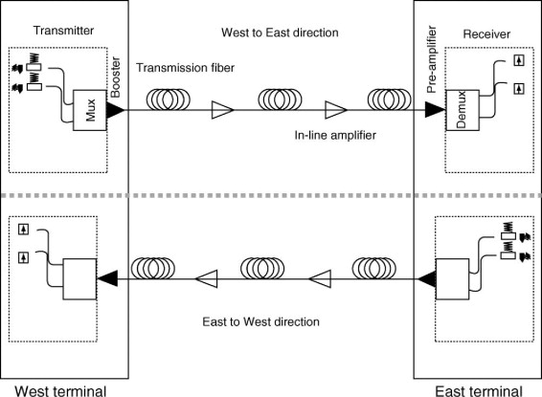
Standard practice
Almost all long distance undersea cables are unidirectional because of the amplifiers
No current intent to upgrade.
Large amount of extra capacity via spare fibres and 10 GHz DWDM channels

Slide 6
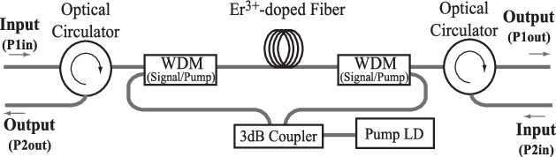
BiDi EDFA
Not a common device
Can have isolators on each input/output
Still uses two fibres
No isolator = more noise

Slide 7
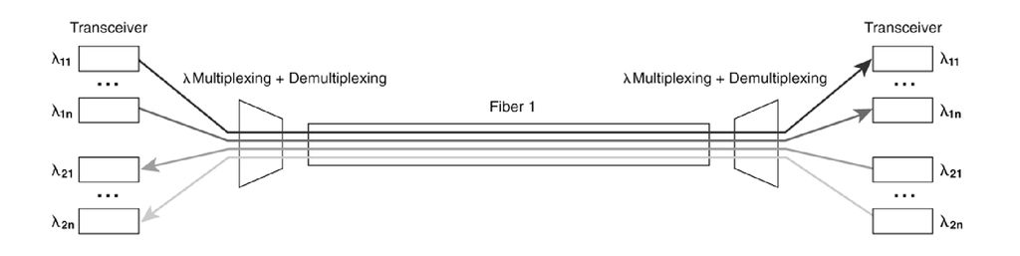
BiDi with WDMs
Need to isolate different channels to prevent interference
Strong effect of Back scattering

